Slide 1
66degrees + Frontdoor
Frontdoor PL/SQL Service Based Modernization Kickoff
August 12, 2026
Notes:
Jackie

Slide 2


Agenda
Welcome & Project Objectives
Team Introductions
Project Scope & Deliverables
Implementation Approach
Anticipated Risks
Project Communication
Next Steps
Notes:
Jackie:
Welcome & Project Objectives
Team Introductions
Project Scope & Deliverables
Implementation Approach
Anticipated Risks
Project Communication
Next Steps

Slide 3
Project Objectives
settings_suggest
Business Logic Modernization
Translate and rewrite 133 legacy PL/SQL database objects into decoupled, independent .NET microservices to provide "equivalent functionality".
layers
Establish Proxy Layer
Design and deliver a containerized microservice proxy layer to manage application communication while retaining the core legacy database.
cloud_queue
Cloud-Native Adaptation
Re-tier legacy, built-in Oracle database mechanisms into cloud-native AWS integration primitives (e.g., S3, SES, KMS).
language
Multi-Region Resiliency
Roll out 18 domain-aligned microservices and 6 shared NuGet libraries to support Frontdoor’s resilience vision.
Notes:
Jackie
Project objectives as outlined in the SOW:
Extract 133 legacy SQL components into .NET microservices and deploy a containerized proxy layer to route traffic while preserving the core database.
Roll out 18 domain-aligned microservices and 6 shared NuGet libraries

Slide 4
Team Introductions
Notes:
Jackie

Slide 5

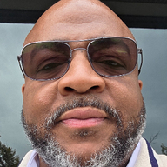
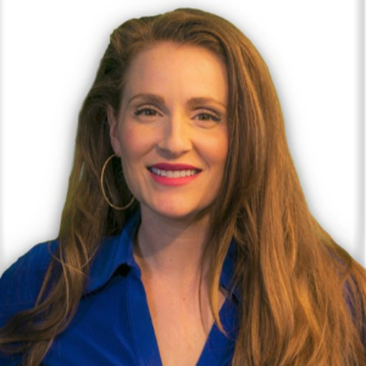
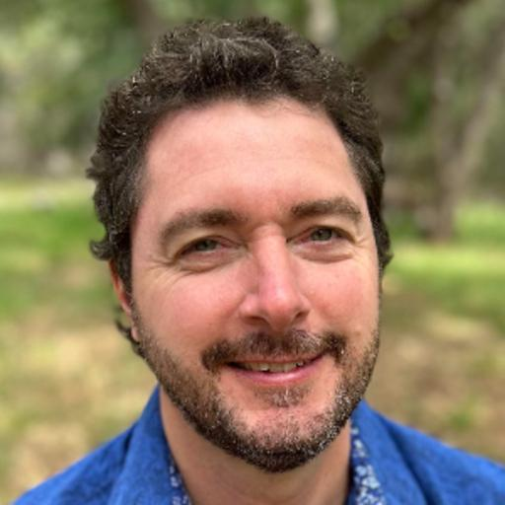


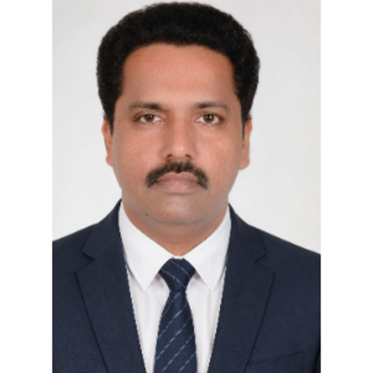
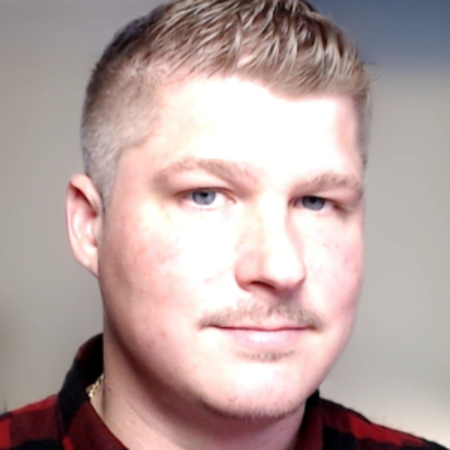
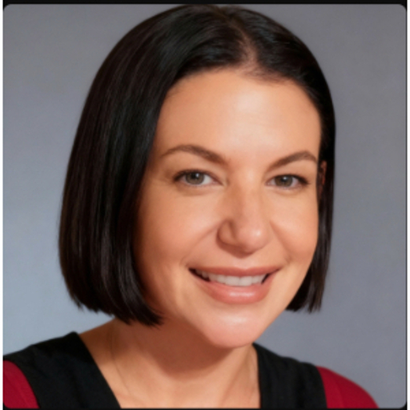


66degrees Team
Paulo Masis
Director of Engineering
Alexandre Little
App Dev Architect
Heather Tole
Client Partner
Duncan Rutland
Delivery Partner
Vivek Vamadevan
App Dev Solution Architect
Surya Manduri
App Dev Architect
Arunakumara YB
App Dev Architect
Nicholas Brandon
Cloud Architect
Jackie Scherer
Delivery Manager
Amit Athalye
Delivery Manager
Notes:
Amit

Slide 6
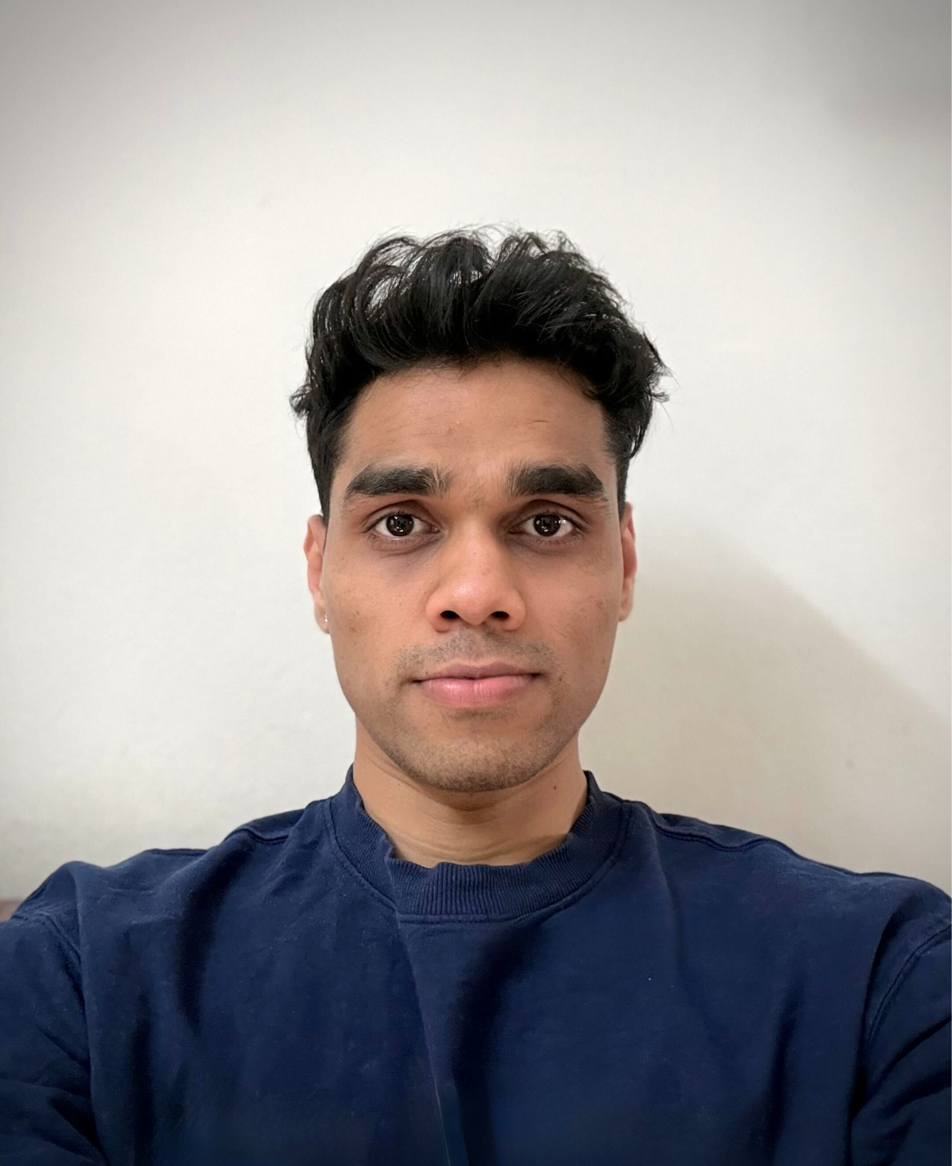

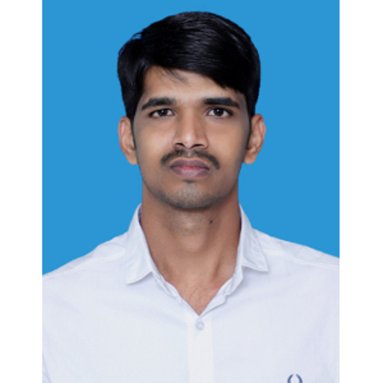
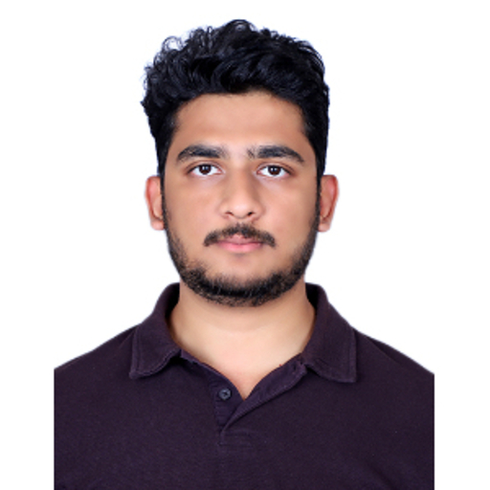
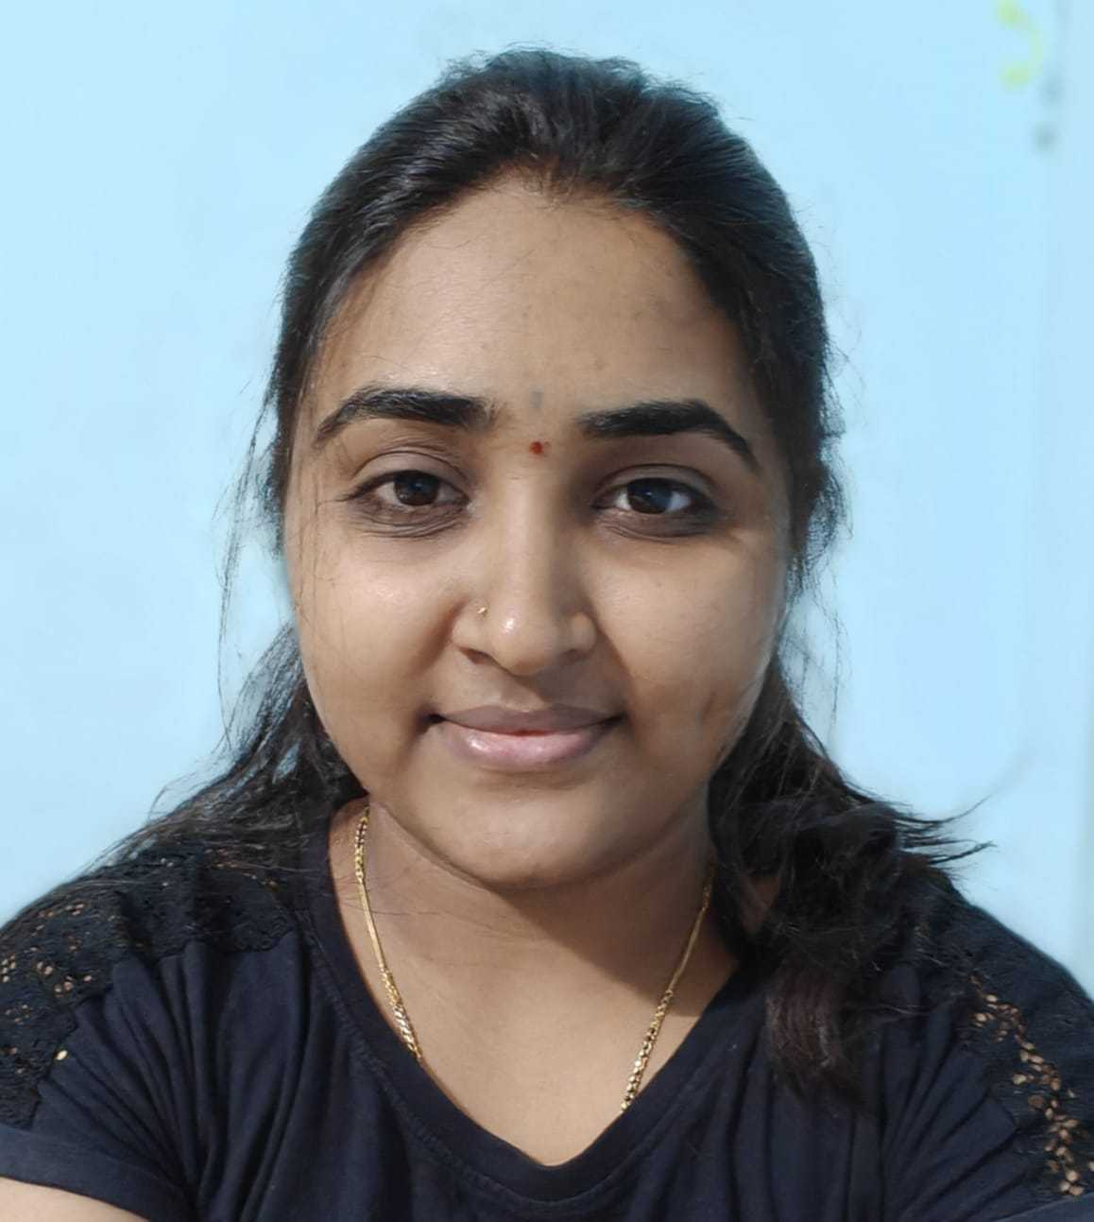
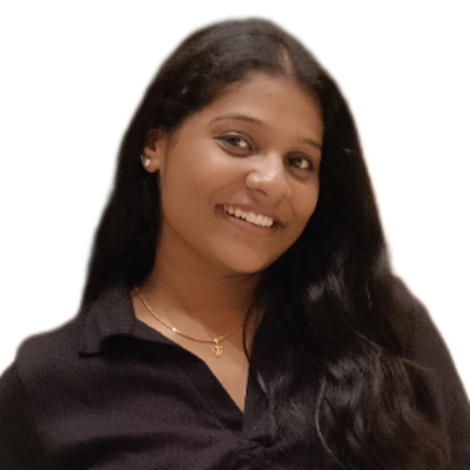
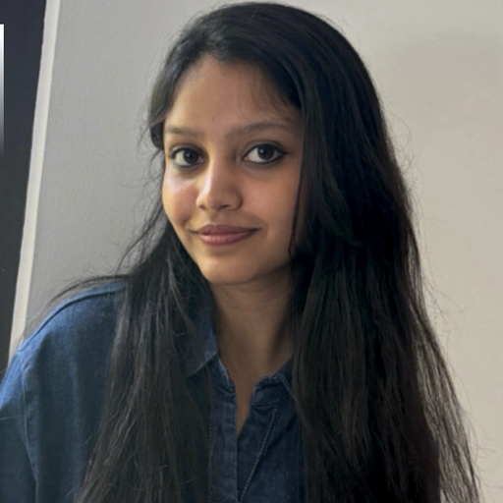
66degrees Team
Jay Zende
Cloud Engineer
Kavitha A N
Cloud Engineer
Pradeep Belgavkar
Backend Engineer
Rohan Gundi
Backend Engineer
Rajeshwari Betagiri
QA Lead
Sneha H
QA Engineer
Farheen Fathima
QA Engineer
Notes:
Amit

Slide 7
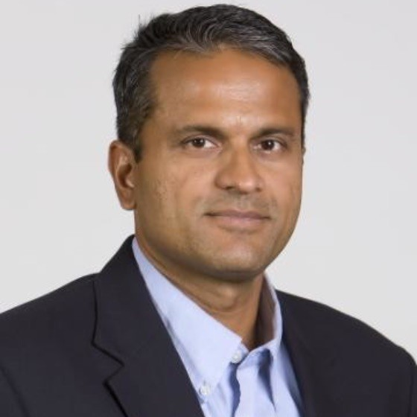

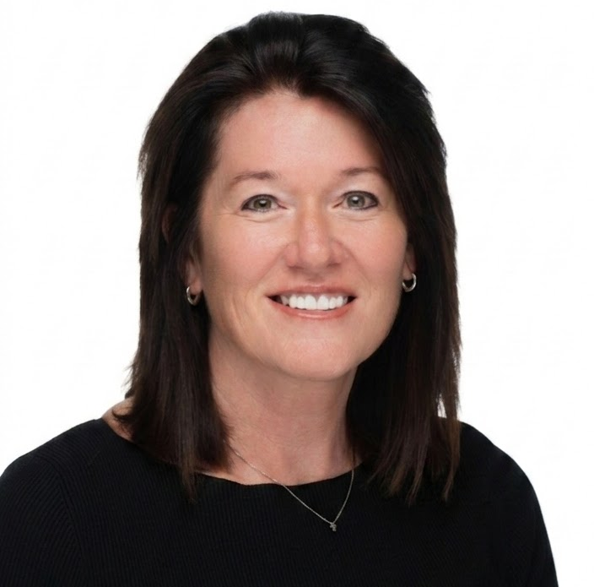
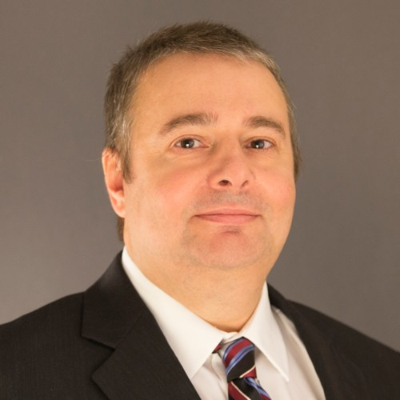
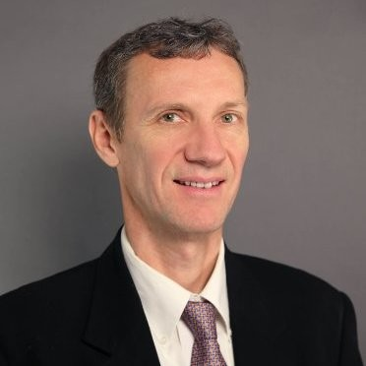

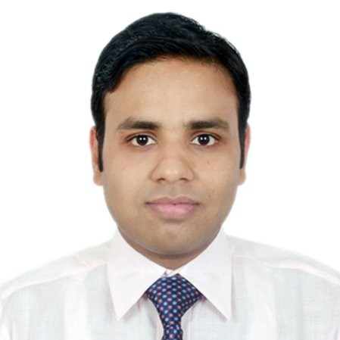
Frontdoor Team
Bala Ganesh
Chief Technology Officer/Executive Sponsor
Andrew Kroes
Director, Data Systems Engineering
Lynda Schirck
Sr Director Quality and Data Engineering
Robert Steward
Application DBA
Denis Pokorny
Software Development Manager
Jesssica King
Senior Sourcing Analyst
Ashish Agarwal
Principal Engineer
Notes:
Amit

Slide 8
Frontdoor Team | Roles & Responsibilities
Frontdoor has agreed to provide the following resources for this engagement:
Role | Responsibility | Frontdoor Team Member
Client Sponsor | Project sponsor empowered to make all client decisions on behalf of the project | Andrew Kroes
Client Point of Contact (POC) | Primary client contact for coordination of all day to day activities and escalations | Andrew Kroes
Client Architect | Client contact who has authority to make all architectural decisions | Robert Steward Denis Pokorny Ashish Agarwal
Client Staff | Designated client staff who will alongside 66degrees during the engagement. Knowledge transfer is provided throughout the engagement, the client is responsible for the availability | Robert Steward Denis Pokorny Ashish Agarwal
Notes:
Discuss while on the call - Jackie

Slide 9


Success Criteria
Technical Criteria
All 133 PL/SQL objects successfully translated.
18 production-ready microservices delivered.
6 reusable shared libraries developed.
Successful deployment on AWS EKS.
Non-Technical Criteria
Functional parity with existing Oracle business logic.
Stable integration with ERP/JDE and downstream systems.
Successful completion of all three modernization phases within scope and quality expectations.
Notes:
Jackie
Technical Criteria: Successfully translating all 133 legacy objects., 18 prod ready microservices, 6 reusable libraries, & a successful deployment on AWS
Non-technical criteria:
Achieve 100% functional parity with existing Oracle logic.
Ensure rock-solid integration with ERP/JDE and downstream systems.
Deliver all three phases on scope, on target, and at the highest quality.

Slide 10
Project Scope & Deliverables

Slide 11
Project Scope
Phase 1
Core Transactional
Functional Scope: Modernization of fifty-two (52) validated PL/SQL objects spanning Sales Origination & Pricing, Service Dispatch, and Vendor Management.
Target Architecture: Provisioning of corresponding .NET microservices deployed via containerization.
Phase 2
Financial & Invoicing
Functional Scope: Modernization of forty-one (41) validated PL/SQL objects spanning Payment Processing, Invoicing, and Commission Calculation.
Target Architecture: Extension of the .NET service mesh, ensuring transactional security parameters are preserved.
Phase 3
ERP & Ledger
Functional Scope: Modernization of twenty-nine (29) validated PL/SQL objects governing Financial Reconciliation with the JDE (ERP) system.
Target Architecture: Finalization of 18 target microservices and logical decoupling from Oracle monolith execution paths.
Notes:
Alex:
Phase 1: The first phase will entail us transferring the true core business logic which should be housed in these business sub domains: Sales Origination $ Pricing, Service Dispatch and Venfor Management, into their domain specific .Net Microservices.
Phase 2 notes
Phase 2 phase will entail us transferring the business logic from Payment Processing, Invoicing, and Commission Calculation. into their domain specific .Net Microservices.
Phase 3 notes
and finally, we will transfer the business logic from Financial Reconciliation with the JDE (ERP) system into their domain specific .Net Microservices. thus handling all of the in scope PL/SQL Stored procedure conversions.

Slide 12
Scope Exclusions
Applications & UIs
Refactoring upstream/downstream consumer apps to point to new microservice endpoints
Modification, testing, or development of web or mobile user interfaces
Refactoring legacy apps (e.g., PowerBuilder) for downstream integration
Infrastructure & Data
Full database modernization beyond specified target service scopes
Creation, configuration, and maintenance of Kubernetes clusters and firewalls
Custom platform or infrastructure activities on the Istio environment
Domains & Compliance
Any business domains beyond Customer & Contract, Service Delivery, Revenue & Financial Operations
Physical decommissioning/deprecation of legacy PL/SQL packages from Oracle
Formal PCI ROC, penetration testing, or corporate SOC2 compliance audits
Notes:
Duncan

Slide 13
Key Assumptions
Architecture & Tech Stack
Existing Oracle database remains unchanged.
Existing Kubernetes and Istio environments are available.
Execution & Methodology
AI-assisted code generation with HITL validation.
Business logic remains functionally identical.
Async Messaging Service wrapper is removed from build scope.
Frontdoor Ownership
Frontdoor provides cloud infrastructure, security, and business analysis.
Consumer applications will be modified by Frontdoor teams.
Frontdoor provides test data, dual-run capability, and domain SMEs.
PCI attestation preparation is Frontdoor's responsibility.
Notes:
Duncan

Slide 14
High-level Milestone Phases
# | Phase | Description | Target Week
0 | Foundation Complete Gate | Shared Libraries built/packaged into NuGet & Istio Strangler POC signed off | 3
1 | Core Transactional Domains | Modernization and translation of 52 validated PL/SQL objects spanning Sales Origination & Pricing, Service Dispatch, and Vendor Management domains into containerized .NET microservices. | 24
2 | Financial & Invoicing Operational Domains | Modernization and rewrite of 41 validated PL/SQL objects covering the Payment Processing, Invoicing, and Commission Calculation domains. | 22
3 | ERP Integration & Ledger Domains | Modernization of the final 29 validated PL/SQL objects governing Financial Reconciliation with the JDE (ERP) system. | 25
Notes:
Paulo

Slide 15
Implementation Approach
Notes:
Paulo

Slide 16
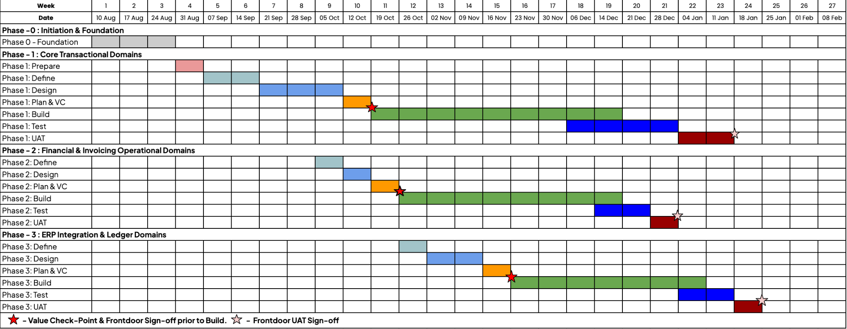
High-Level Timeline (Pending Gap Remediation)
Notes:
Paulo

Slide 17
Gap Remediation Sessions
Session | Summary | Attendees | Target Date
Core Transactional | Confirming business logic, needed code changes and dead code, | 66d + Frontdoor Tech Team
Financial & Invoicing | Confirming business logic, needed code changes and dead code. | 66d + Frontdoor Tech Team
ERP & Ledger | Confirming business logic, needed code changes and dead code. | 66d + Frontdoor Tech Team
Infrastructure Overview | Confirming current infrastructure and what can be leveraged. | 66d + Frontdoor Infra Team
Deployment Pipelines & Artifacts | Identifying how deployment needs to happen, what is required from the 66 team’s end, and the overall process. | 66d + Frontdoor Infra Team
Demo Session | A full demo session of Frontdoor’s current system. | 66d + Frontdoor Business Team
Notes:
Alex :
•Core Transactional – Confirming business Logic, Needed code Changes and dead code. 2 hours each session
•Financial & Invoicing - Confirming business Logic, Needed code Changes and dead code. 2 hours each session
•ERP & Ledger - Confirming business Logic, Needed code Changes and dead code. 2 hours each sesssion
•Infrastructure Overview – Confirming the clients current infrastructure and what can be leveraged. 1 hour.
•Deployment Pipelines & Artifacts – Identifying how deployment needs to happen, what is required from our end, and the overall process
•Demo Session – A full demo session of their current system. 1 hour

Slide 18
S/W Approach: API Modernization Process
Architectural Overview
The goal is to analyze 133 PL/SQL stored procedures and securely expose them via .NET API endpoints.
Strategic redesign focusing on business rules, dependencies, and performance patterns.
Key Deliverables:
API Endpoint Catalog & Swagger Specs
Traceable Procedure-to-API Mapping Matrix
Standard Response & Error Design
Success Payload (200 OK)
{
"data": { "customerId": 125 },
"success": true,
"correlationId": "c81b9ec5..."
}
Error Payload (400/500)
{
"success": false,
"errorCode": "NOT_FOUND",
"correlationId": "c81b9ec5..."
}
Iterative API Modernization Roadmap (Phases 0 - 3)
0. Deep Dive Inventory
Scope & Catalog
Analyze tables, views, parameters, triggers, and existing app callers to build a central tracking inventory.
1. Functional Analysis
Business Mapping
Expose business rules via unified routes (e.g. POST /api/orders) instead of raw DB actions.
2. Technical Dependency
Risk Classification
Categorize components as Independent, Internally/Cross-System Dependent, or High-Risk.
3. Complexity & Waves
Execution Planning
Score complexity (L1 Read to L4 Async/Specialized) and segment modernization into phased deployment waves.
Notes:
Alex : The goal is to analyze 133 PL/SQL stored procedures and securely expose them via .NET API endpoints.
Strategic redesign focusing on business rules, dependencies, and performance patterns. As well as Identifying any outdated business logic and truly dead code.
With deep Dive, some of this work has already been done, with the initial analysis, but the main point with this is getting a better understanding of what exactly each stored proc does (business wise) and what changes need to be made if any, and what code is truly dead code. With the FUnctional Analysis we are going to be mapping those business function to their respective doman end points, The technical dependency will give us a heirachial view of the importance of each business function and these things will allow us to put our tasks into user stories and create deployment waves for the various parts of the project. One note to take away is that some of these can be done together, and some may overlap others.

Slide 19
Anticipated Risks

Slide 20
Identified Risks & Issues
# | Description/Status | Type | Status | Impact | Likelihood | Owner | Date Raised | Mitigation need by: | Impacts(s)
 |  |  |  |  |  |  |  |  | Sched | Scope | Budget
1 | Frontdoor to grant access to the 66 team | Risk | Open | High | Medium | Andy | 8/5/2026 | 8/12/2026 | X | X
Mitigation Plan & Actions |  | Andy working on getting off-shore team’s access.
2 | Gap Remediation sessions scheduling | Risk | Open | Medium | High | Jackie | 8/10/2026 | 8/14/2026 | X | X
Mitigation Plan & Actions |  | Identify agenda and attendees for each session and schedule
Notes:
Jackie:
A few risks: Access to Frontdoor’s systems that Andy is currently working on securing
Jackie Working with the FD team to schedule the gap remediation sessions

Slide 21
Communication Plan
Notes:
Amit

Slide 22
Project Communications & Collaboration
Meetings & Cadence
A weekly engagement status meeting is scheduled to formally review project status, verify next steps, and address project risks and issues. *First 6 weeks of engagement we will meet twice a week (Monday & Thursdays 8:30 CST)
A more detailed project schedule that is mutually agreeable to both parties will be established at the outset of the project.
The project will include collaborative gap remediation and requirements definition sessions.
A knowledge transfer and closeout meeting will be conducted at the end of the project to recap goals, summarize lessons learned, and review deliverables.
As part of the Organizational Change Management (OCM) scope, a communication strategy and plan will be developed.
Reporting & Deliverables
A Status Report deliverable will be provided ongoing throughout the project.
These reports will track project progress against the schedule, deliverables, and risks.
OCM documentation will also be a deliverable, which includes the communication strategy, metrics plan, and executive meeting content.
Notes:
Amit

Slide 23
Communication Channels & Frequency
Daily Stand-up Meetings (15 min):
Purpose: Quick updates on "what I did yesterday, what I'm doing today, any blockers."
Weekly Core Team Meeting (30 min):
Purpose: Detailed progress review, deep dive into specific issues, decision-making, planning for the upcoming week.
Dedicated Google Chat/Slack Channel:
Purpose: Real-time communication, quick questions, sharing links, immediate problem-solving.
Project Management Tool (e.g., Jira, Asana):
Purpose: Task assignment, progress tracking, documentation of issues and resolutions, backlog management.
Shared Document Repository:
Purpose: Central repository for all project documentation (SOWs, technical designs, meeting notes, etc.).
Email (as needed):
Audience: Specific team members or broader project group.
Purpose: Formal notifications, urgent alerts, detailed explanations not suitable for chat, follow-ups on specific action items.
Frequency: As required.
Notes:
Amit

Slide 24
Next Steps

Slide 25

What to Expect
Customer Satisfaction Surveys
End-of-Project Surveys
Your feedback is essential to helping 66degrees gauge your experience and ensure continued satisfaction throughout each project lifecycle.
In addition to ongoing communication, we will be sending out periodic Customer Satisfaction Surveys to gain your perspective on:
Overall Experience
Quality of Deliverables
Project Team Expertise
Communication & Project Management
Any additional information you’d like to share
The surveys will take less than 1 minute to complete.
Notes:
Jackie : CSTATS are very important to us at 66degrees. We’ll be sending out Customer Satisfaction Surveys periodically - survey takes less than a minute to complete and we strive for 5’s here at 66. If for any reason you don’t feel like we are delivering at a 5, please reach out to let us know what we can do to make it us a 5 in your eyes.

Slide 26
Next Steps
Send recap / action items
Gap Remediation Sessions
Approach Alignment Sign-off
Finalize Timeline
Notes:
Jackie
Next steps:
I’ll send a recap of this call with the deck and action items
I’ll be reaching out to the FD team to schedule the gap remediation sessions
After the sessions and the scope is defined, we’ll send over the approach alignment for sign-off and we’ll finalize the timeline with a more detailed timeline.

Slide 27
Q & A

